Slide 1

Entering data into EGRET and running an analysis
Laura DeCicco
Civil Engineer
March 26, 2019

Slide 2
But first, some housekeeping and definitions: First one is censored data (can be “less thans” or “greater thans”)

Slide 3
Sample concentrations are stored as an interval from ConcLow to ConcHigh
Uncensored case: ConcLow = ConcHigh
Censored case: Say the value is reported as < 1.0 mg/L
Then ConcLow = NA and ConcHigh = 1.0
The math is handled using “survival analysis”, also know as “tobit regression.”

Slide 4
The tricky case of compound analytes
Sometimes an analyte of interest is the sum of two or more measured analytes. Here is a real example for Total Nitrogen in the Susquehanna River, Maryland, April 27, 1988.
The rule is: Compute Total N as Ammonia plus organic N, unfiltered + Nitrate plus nitrite, filtered
The two analyte values were reported as <0.2 and 0.9 mg/L respectively. Therefore, this data point has ConcLow = 0.9 and ConcHigh = 1.1.
The conventional left-censored approach calls this (0,1.1), but EGRET sees it as an interval (0.9, 1.1)

Slide 5
“Period of Analysis” concept in EGRET. When we build summaries, what is our unit of time?
We can define the period with two arguments:
paStart = calendar month that starts the period
paLong = length of period, in months
Could be water year
Could be calendar year
Could be April-May-June
Could be Dec-Jan-Feb-Mar
Could be only May…

Slide 6
Period of analysis set up
Say we want calendar year
eList <- setPA(eList, paStart = 1, paLong=12)
Say we want April, May, June
eList <- setPA(eList, paStart = 4, paLong = 3)
Default is water year

Slide 7
What if I have no data for certain parts of the year?
Estimate the WRTDS model as if you did have good coverage, but recognize that the estimate during the parts of the year with no data are meaningless.
Then for summaries use setPA so that it only provides results for the valid parts of the year.

Slide 8
Units in EGRET
Everything stored as:
m³/s, kg/day, or mg/L
But each graphic or table has a wide choice of units (English and SI) that the user can select

Slide 9
printqUnitCheatSheet() | > printFluxUnitCheatSheet()
The following codes apply to the qUnit list: 1 = cfs ( Cubic Feet per Second ) 2 = cms ( Cubic Meters per Second ) 3 = thousandCfs ( Thousand Cubic Feet per Second ) 4 = thousandCms ( Thousand Cubic Meters per Second ) | The following codes apply to the fluxUnit list: 1 = poundsDay ( pounds/day ) 2 = tonsDay ( tons/day ) 3 = kgDay ( kg/day ) 4 = thousandKgDay ( thousands of kg/day ) 5 = tonsYear ( tons/year ) 6 = thousandTonsYear ( thousands of tons/year ) 7 = millionTonsYear ( millions of tons/year ) 8 = thousandKgYear ( thousands of kg/year ) 9 = millionKgYear ( millions of kg/year ) 10 = billionKgYear ( billions of kg/year ) 11 = thousandTonsDay ( thousands of tons/day ) 12 = millionKgDay ( millions of kg/day ) 13 = kgYear ( kg/year )

Slide 10
EGRET data structure: the eList
Having a standard set of names for data frames and variable and their units is an important attribute of EGRET
EGRET users and the EGRET authors can collaborate easily because of we all share the same set of names and definitions. “I can’t figure out what’s going on” – my answer – “Send me your workspace”
EGRET is a platform for many other possible analyses beyond WRTDS. It is a toolbox for manipulating these types of data.

Slide 11
What is the eList: 4 components
INFO a data frame of metadata: site, analyte, & analysis.
Daily a data frame where every row is a day (no gaps):
To start it is just discharge and various measures of time
After analysis it also contains the estimates
Sample: a data frame where every row is a sample
To start it is just the sample values and time
After analysis it also contains cross-validation estimates
surfaces: a 3 dimensional array (the contour plot)

Slide 12
Two ways to create the eList
eList <- mergeReport(INFO, Daily, Sample)
eList <- as.egret(INFO, Daily)
the second one is all you need to look at discharge history

Slide 13
The software: how do I get it?
Need to install R (freely downloaded from http://cran.us.r-project.org/) on your computer
Once you start R, you can load the software:
install.packages(”EGRET”)
library(EGRET)
Our web page:
http://usgs-r.github.io/EGRET/

Slide 14

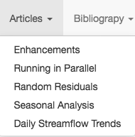
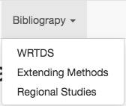
http://usgs-r.github.io/EGRET/

Slide 15
A digression, dataRetrieval
An all purpose package for obtaining all types of data from USGS NWIS and the Water Quality Portal

Slide 16
dataRetrieval
Acquire data from web services (USGS or the Water Quality Portal) or from user-supplied files
Includes capability for sample data, daily discharge, other daily values, sensor data, and meta data about site and parameter
EGRET uses dataRetrieval and then structures it for the specific EGRET data frames

Slide 17
dataRetrieval functions:
By information source and purpose
Information Source | Site Query | Meta Data | Data
NWIS
Water Quality Portal

Slide 18
dataRetrieval functions:
By information source and purpose
Information Source | Site Query | Meta Data | Data
NWIS | whatNWISsites whatNWISdata | readNWISsite readNWISpCode | readNWISdata readNWISdv readNWISqw readNWISuv readNWISrating readNWISmeas readNWISpeak readNWISgwl
Water Quality Portal | whatWQPsites |  | readWQPqw readWQPdata
A little example of one of these functions

Slide 19
Unit values retrieval (not used by EGRET)
Raccoon River at Van Metre, IA
Nitrate sensor data
March – Sept 2013

Slide 20
Bring in all the data
Unit<-readNWISuv("05484500",parameterCd=c("99133","00060"),"2013-03-01","2013-09-30")
Creates a data frame of 19,568 time steps, discharge missing for 86 of them, nitrate missing for 1,848 of them.
Unit<-na.omit(Unit)
Now we have a data from of 17,634 rows
all of which have discharge and nitrate

Slide 21
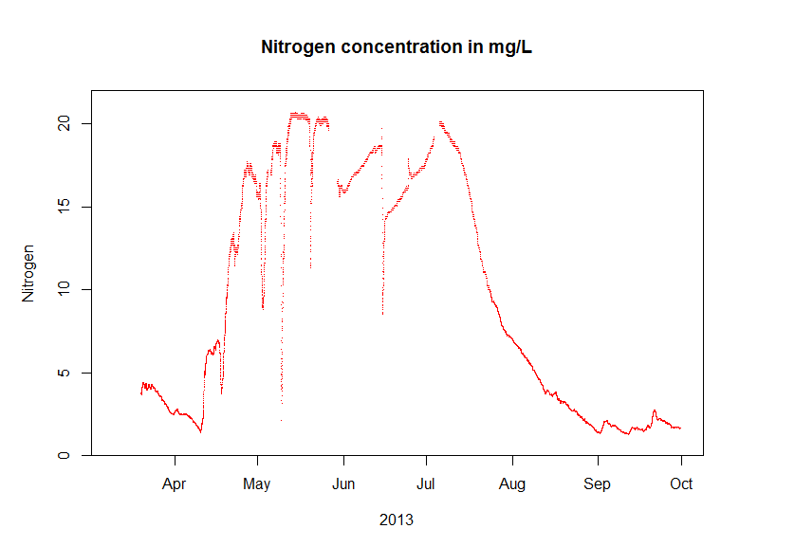
> with(Unit, plot(datetime,X18_99133_00011,
col="red",pch=".",ylim=c(0,22),yaxs="i",
xlab="2013",ylab="Nitrogen",
main="Nitrogen concentration in mg/L"))

Slide 22
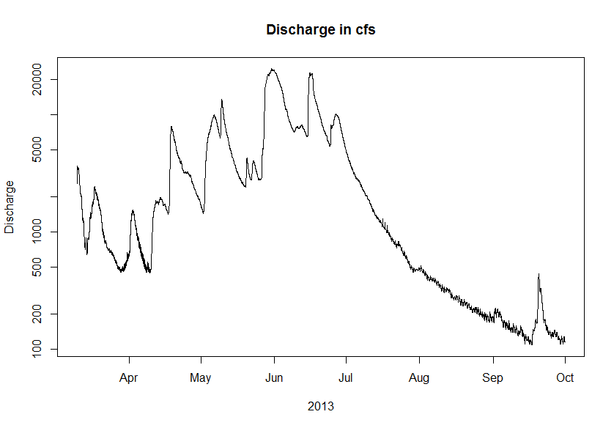
> with(Unit, plot(datetime, X01_00060_00011,
col="black", log="y", type="l",
xlab="2013", ylab="Discharge",
main="Discharge in cfs"))

Slide 23
Using EGRET
For each session the code needs to be loaded:
library(EGRET)
Once this is done you will have access to help and to the package vignettes.
To get help with a function (such as the function readNWISSample) just type ?readNWISSample

Slide 24
How can we enter data?
For the water quality sample data
From USGS web services
From Water Quality Portal
From a user supplied file
For the daily discharge data
From USGS web services
From a user supplied file
For the meta-data
From USGS or Water Quality Portal
From user entries

Slide 25
> library(EGRET)
> site <- "01491000"
> parameterCd <- "00631"
> startDate <- "1979-10-01"
> endDate <- "2014-09-28"
> Sample <- readNWISSample(site,parameterCd,startDate,endDate)
> summary(Sample)
Sample data frame of 708 rows (one per sample) with columns for:
Date, Concentration, Days since January 1, 1850, Month of the year, Day of the year, Decimal year, sine and cosine of time of year, and censoring information.

Slide 26
EPA Storet Data from the Water Quality Portal
> siteNumber<-"IL_EPA_WQX-BPK-07"
> characteristicName<-"Inorganic nitrogen (nitrate and nitrite)"
> startDate<-"2005-01-01"
> endDate<-"2013-12-31"
> Sample<-readWQPSample(siteNumber,characteristicName,startDate,endDate)
> summary(Sample)
Date ConcLow ConcHigh Uncen ConcAve Julian
Min. :2005-01-24 Min. : 0.041 Min. : 0.0180 Min. :0.0 Min. : 0.0090 Min. :56636
1st Qu.:2009-02-08 1st Qu.: 3.658 1st Qu.: 0.1905 1st Qu.:1.0 1st Qu.: 0.1905 1st Qu.:58112
Median :2010-01-07 Median : 5.205 Median : 4.5950 Median :1.0 Median : 4.5950 Median :58446
Mean :2009-05-21 Mean : 4.834 Mean : 3.8710 Mean :0.8 Mean : 3.8692 Mean :58215
3rd Qu.:2011-03-03 3rd Qu.: 6.560 3rd Qu.: 6.2250 3rd Qu.:1.0 3rd Qu.: 6.2250 3rd Qu.:58866
Max. :2011-11-28 Max. :11.400 Max. :11.4000 Max. :1.0 Max. :11.4000 Max. :59135
NA's :8
Month Day DecYear MonthSeq SinDY CosDY
Min. : 1.000 Min. : 10.0 Min. :2005 Min. :1861 Min. :-0.997917 Min. :-0.99867
1st Qu.: 4.000 1st Qu.: 96.5 1st Qu.:2009 1st Qu.:1910 1st Qu.:-0.739146 1st Qu.:-0.69630
Median : 6.500 Median :184.0 Median :2010 Median :1921 Median : 0.000000 Median :-0.14961
Mean : 6.425 Mean :179.5 Mean :2009 Mean :1913 Mean :-0.009202 Mean :-0.07491
3rd Qu.: 9.000 3rd Qu.:256.2 3rd Qu.:2011 3rd Qu.:1934 3rd Qu.: 0.740889 3rd Qu.: 0.62203
Max. :12.000 Max. :349.0 Max. :2012 Max. :1943 Max. : 0.999250 Max. : 0.98666
> length(Sample$Date)
[1] 40

Slide 27
Daily <- readNWISDaily(site,"00060",startDate,endDate)
Daily: a data frame of 12,782 rows (one per day) with columns for:
Date, Discharge, Days since January 1, 1850, Month of the year, Day of the year, Decimal year, mean flow for past 7 days, mean flow for past 30 days

Slide 28
A note about record length
For a standard WRTDS analysis, the Daily data frame must cover the whole span of data in the Sample data frame, but should not extend far beyond it (e.g. cover full water years)
For WRTDS with generalized flow normalization it is good to have the Daily data frame extend several years before and after the sample record if feasible

Slide 29
Storing the metadata
For NWIS data INFO<-readNWISInfo(site, parameterCd)
Similar function for the Water Quality Portal

Slide 30
Storing the metadata
The contents of INFO are used to label tables and figures as well as document the site and constituent information
Creates a system of abbreviations to keep track of workspace files

Slide 31
> INFO<-readNWISInfo(site,parameterCd)
Your site for streamflow data is 01491000 .
Your site name is CHOPTANK RIVER NEAR GREENSBORO, MD ,but you can modify this to a short name in a style you prefer.
This name will be used to label graphs and tables.
If you want the program to use the name given above, just do a carriage return, otherwise enter the preferred short name(no quotes):
<cr>

Slide 32
The latitude and longitude of the site are: 38.99719 , -75.78581 (degrees north and west).
The drainage area at this site is 113 square miles which is being stored as 292.6687 square kilometers.
It is helpful to set up a station abbreviation when doing multi-site studies, enter a unique id (three or four characters should work).
It is case sensitive. Even if you don't feel you need an abbreviation for your site you need to enter something (no quotes):
Chop

Slide 33
Your water quality data are for parameter number 00631 which has the name:' Nitrate plus nitrite, water, filtered, milligrams per liter as nitrogen '.
Typically you will want a shorter name to be used in graphs and tables. The suggested short name is:' Nitrate-nitrite '.
If you would like to change the short name, enter it here, otherwise just hit enter (no quotes):
Nitrate, filtered, as N

Slide 34
The units for the water quality data are: mg/l as N .
It is helpful to set up a constiuent abbreviation when doing multi-constituent studies, enter a unique id (three or four characters should work something like tn or tp or NO3).
It is case sensitive. Even if you don't feel you need an abbreviation you need to enter something (no quotes):
no3

Slide 35
If you are using user-supplied data, you run the interactive command: > INFO <- readUserInfo() 4 fields in INFO are required:
A site name
A parameter name
A site abbreviation
A parameter abbreviation

Slide 36
Two more commands before we can start our analysis of the data
> eList <- mergeReport(INFO,Daily,Sample)
> eList <- mergeReport(INFO,Daily,Sample)
Discharge Record is 12782 days long, which is 35 years
First day of the discharge record is 1979-10-01 and last day is 2014-09-28
The water quality record has 708 samples
The first sample is from 1979-10-24 and the last sample is from 2014-08-13
Discharge: Minimum, mean and maximum 0.00991 4.17 246
Concentration: Minimum, mean and maximum 0.05 1.1 2.4
Percentage of the sample values that are censored is 0.14 %
Now, look at your data. No excuses!!

Slide 37
> multiPlotDataOverview(eList, qUnit=1)

Slide 38
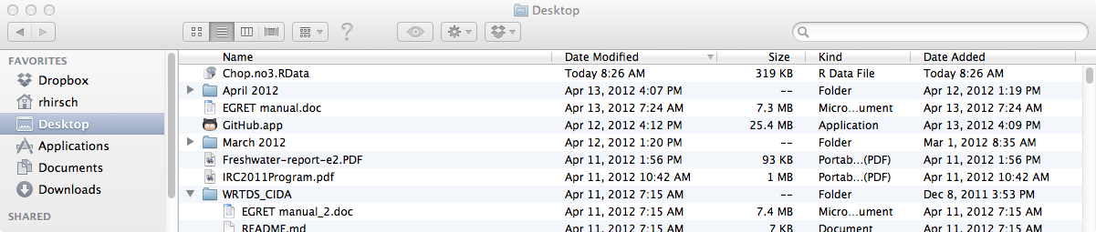
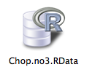
We’ve gone to all this effort, let’s save our work
> savePath<-"/Users/rhirsch/Desktop/"
> saveResults(savePath,eList)
Save it over and over as you proceed and add results

Slide 39
Batch processing
Everything we are showing can be done in batch mode
We recommend, when getting started, start by working with some of your data sets interactively

Slide 40
We now have 3 data frames, bound together in eList
Sample (708 rows, 14 columns)
Daily (12,782 rows, 12 columns)
INFO (1 row, 53 columns)

Slide 41
> eList <- modelEstimation(eList)
Runs the model in cross-validation mode
Estimates the “surface” for concentration as a function of time and discharge
Uses the surface to compute daily values of:
ConcDay, FluxDay, FNConc, FNFlux
Updates eList (INFO, Daily, Sample, surfaces)
User has choices about some of the parameters of the WRTDS model

Slide 42
> plotConcHist(eList)

Slide 43
> plotFluxHist(eList,fluxUnit=8)

Slide 44
> eList <- setPA(paStart=3,paLong=4) > plotFluxHist(fluxUnit=8)

Slide 45
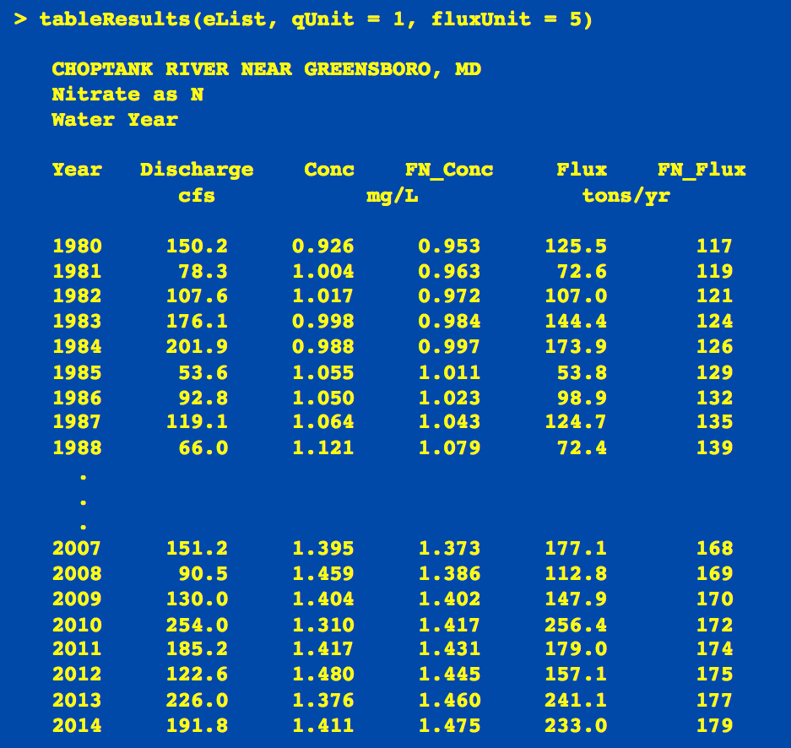

Slide 46
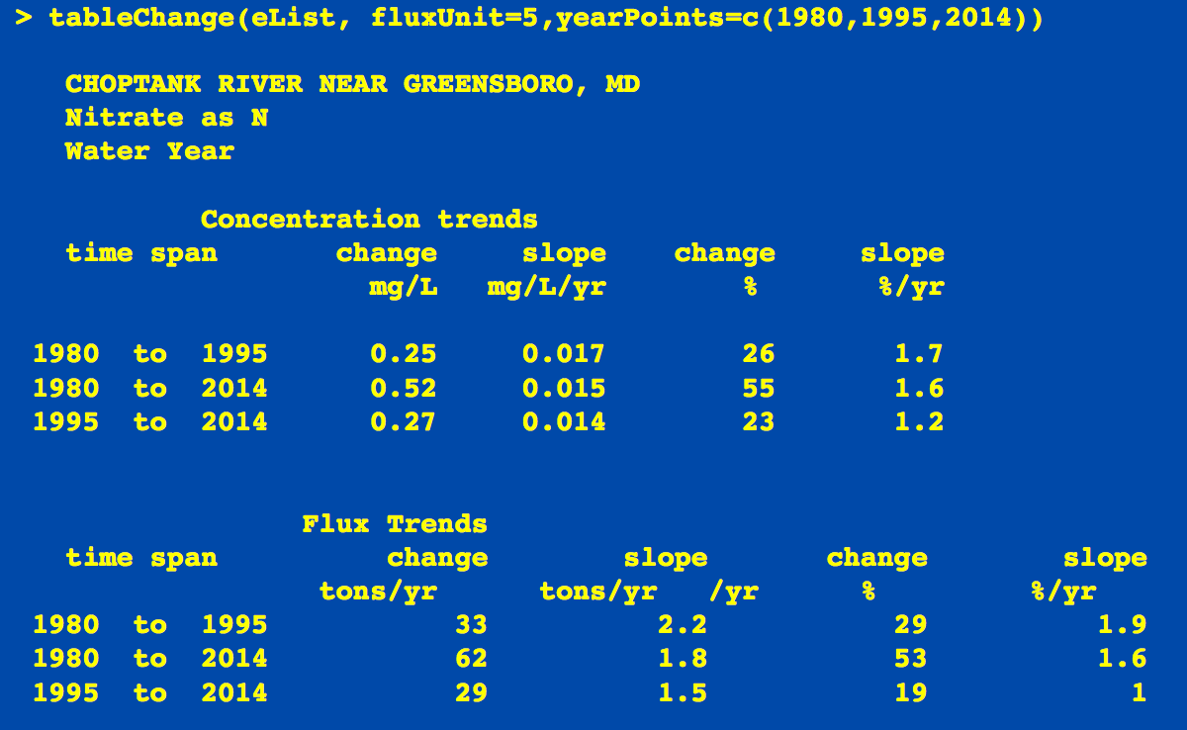
Notes:
Bootstrap 1980 – 2014, Concentration pval < 0.031, 90% CI 41% to 66% Flux pval < 0.031, 90% CI from 38% to 73%
From 1995 – 2014, Concentration pval < 0.031, 90% CI 16% to 29%, Flux pval < 0.031, 90% CI from 11 % to 28%

Slide 47
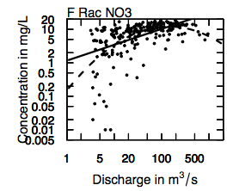
I’m going to switch data sets to Nitrate for the Raccoon River at Des Moines Iowa

Slide 48
EGRET produces a diagnostic plot to help spot serious problems with the model
fluxBiasMulti(eList,
fluxUnit=4)

Slide 49
This same type of plot can be used to look at other models, here the LOADEST7

Slide 50
Diagnostics and potential problems with estimating mean flux, see:
Hirsch, R.M., 2014, Large biases in regression-based constituent flux estimates: causes and diagnostics. Journal of the American Water Resources Association.
Bottom line, look at the fit before you use a statistical model!!!

Slide 51
How difficult is it to make those contour plots?
>plotContours(eList,yearStart=1970, yearEnd=2005, qBottom=2, qTop=200, qUnit=2, contourLevels=seq(0,300,50))

Slide 52
There are many more graphics, for example
> plotConcQSmooth(eList,"1975-08-01”, "1988-08-01", "2010-08-01", qLow=10, qHigh=300, qUnit=2, logScale=TRUE, legendLeft=100, legendTop=0.05)

Slide 53
Preview of second part
Significance levels and confidence intervals for trends
Dealing with nonstationarity in Q
Dealing with abrupt changes (e.g. wastewater treatment upgrades)

Slide 54
New and developing topics
Confidence intervals for annual flux
Improved estimates of actual concentrations and fluxes (WRTDS-K)
Trends in frequency of exceedance
Ephemeral streams
Uncertainty in reservoir mass balance

